Slide 1




INFOSYS SPRINGBOARD
A Task Management & Helper Connecting Platform
Submission Date: 1st April 2026
Submitted By: Batch-13

Slide 2
Project Overview:
Hire Helper is a task management platform where users can post tasks and others can request to
help. The system includes task management, request handling, notifications, and profile settings..
The platform allows users to:
Post tasks with required details such as location, time, and description.
Browse available tasks posted by others.
Send and receive task requests.
Accept or reject requests.
Receive real-time notifications.
Manage personal profile and settings.
The system ensures smooth communication between task owners and helpers, making task management simple, efficient, and user-friendly.

Slide 3
Project Objectives
Connect Task Owners with Helpers Develop a platform that efficiently connects task owners with helpers.
01
Simplify Task Posting s Management Make task creation and management simple for
every user.
02
Enable Request Management Let users send and manage task requests easily with accept/reject controls.
03
04 Real-time Notifications Provide real-time alerts for better communication between users.
User-Friendly s Responsive Interface Deliver an intuitive design that works across all devices.
05

Slide 4
Technologies Used
Full-stack technology stack powering Hire Helper
Frontend
React JS
HTML | CSS | JavaScript
Component-based UI framework
Backend
Node.js
REST APIs | Real-time updates
Server-side runtime environment
UI Design
Figma
Wireframing | Prototyping
Responsive design mockups
Version Control
Git s GitHub
Code repository | Collaboration
Branching | Version tracking

Slide 5
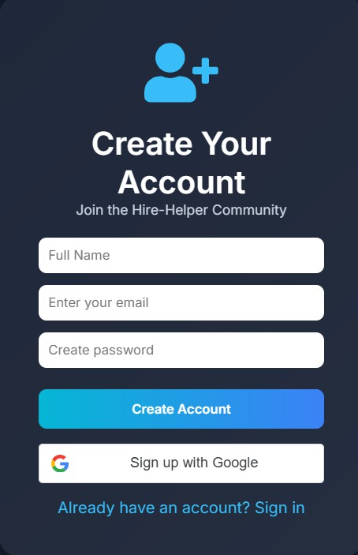
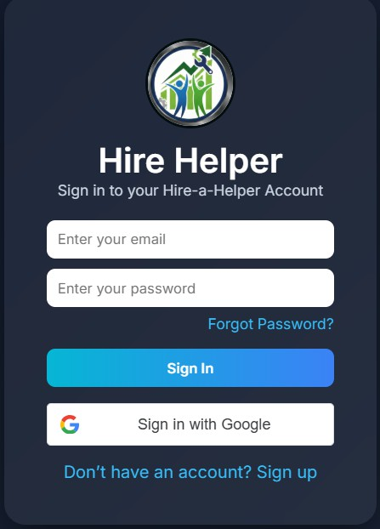
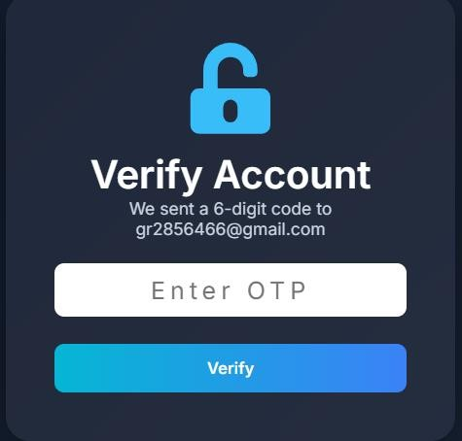

Authentication and Dashboard Setup:
1.Secure user registration and login system. 2.OTP-based authentication for verification.
3. Interactive dashboard with sidebar navigation.

Slide 6
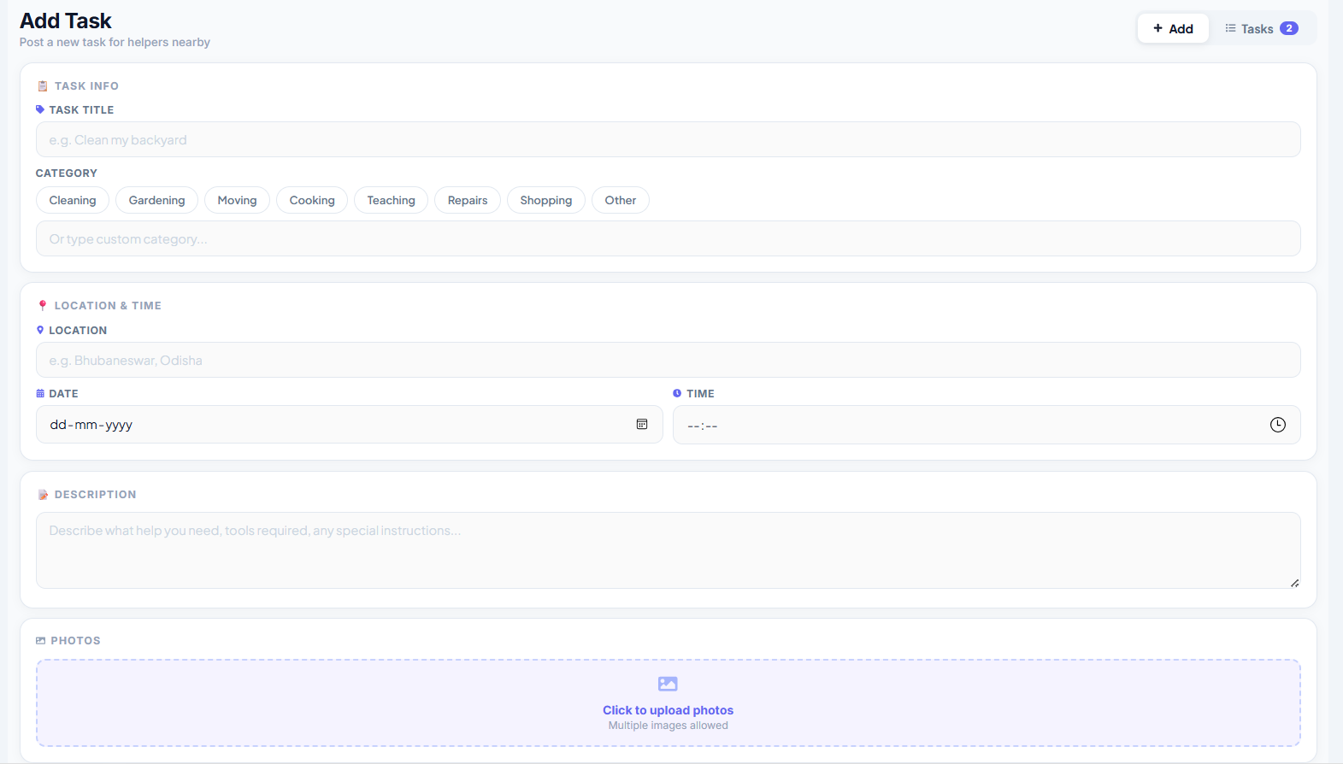
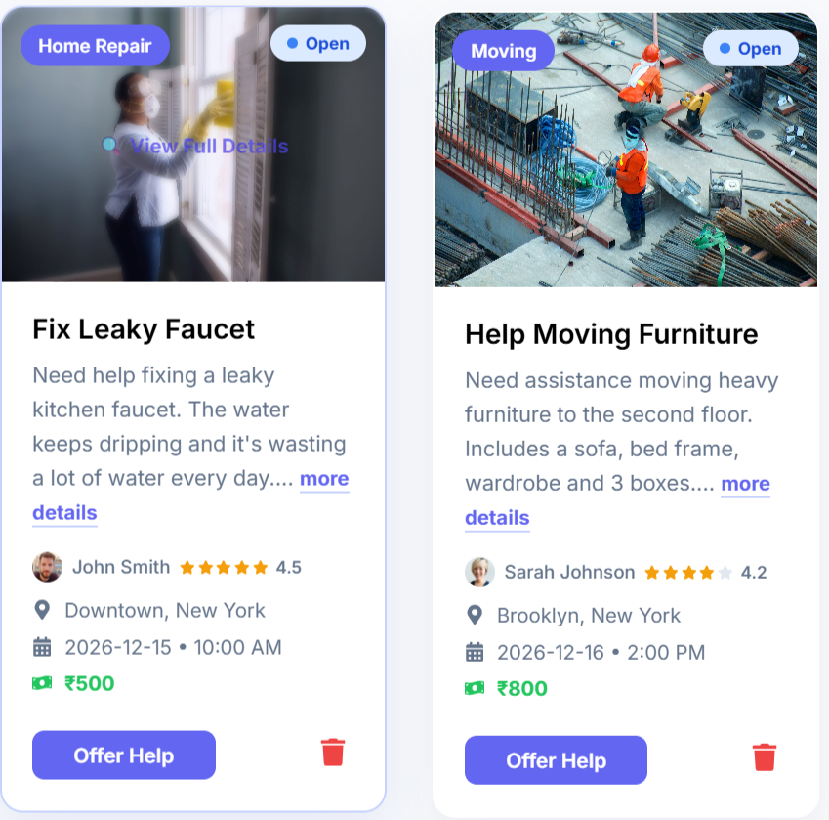
Task Management:
Users can create task with detailed information.
Task listing and browsing functionality.
Simple and efficient task management system.

Slide 7
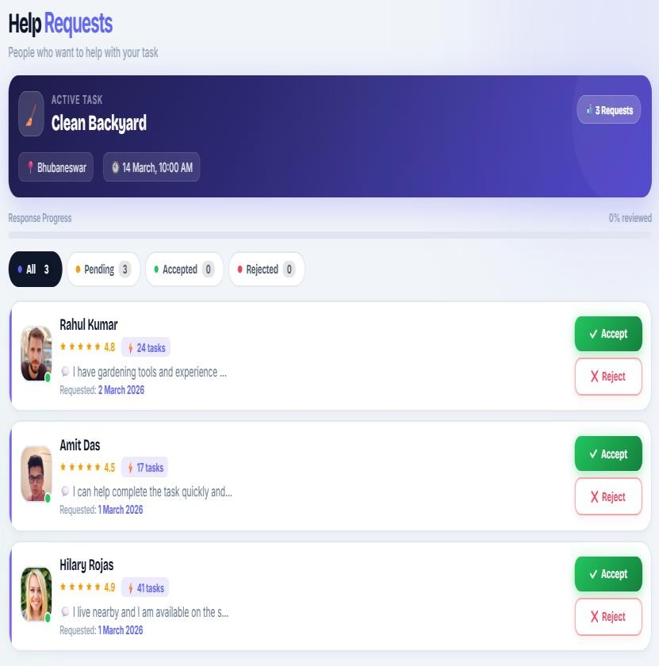
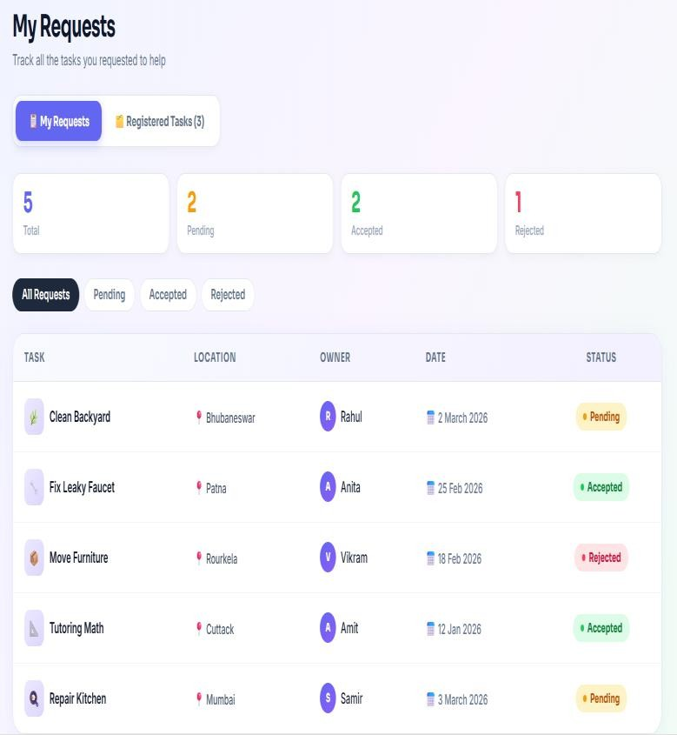
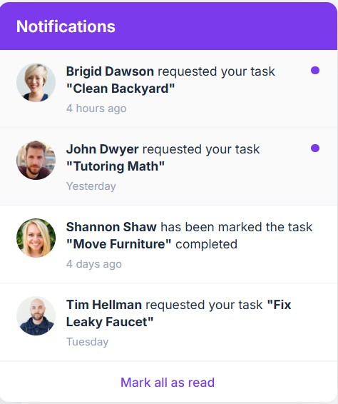
Request and Notifications:
Users can send requests for available tasks.
Task owners can accept or reject requests.
“My Requests” and “Requests” management system.
Real-time notification system for task updates.

Slide 8
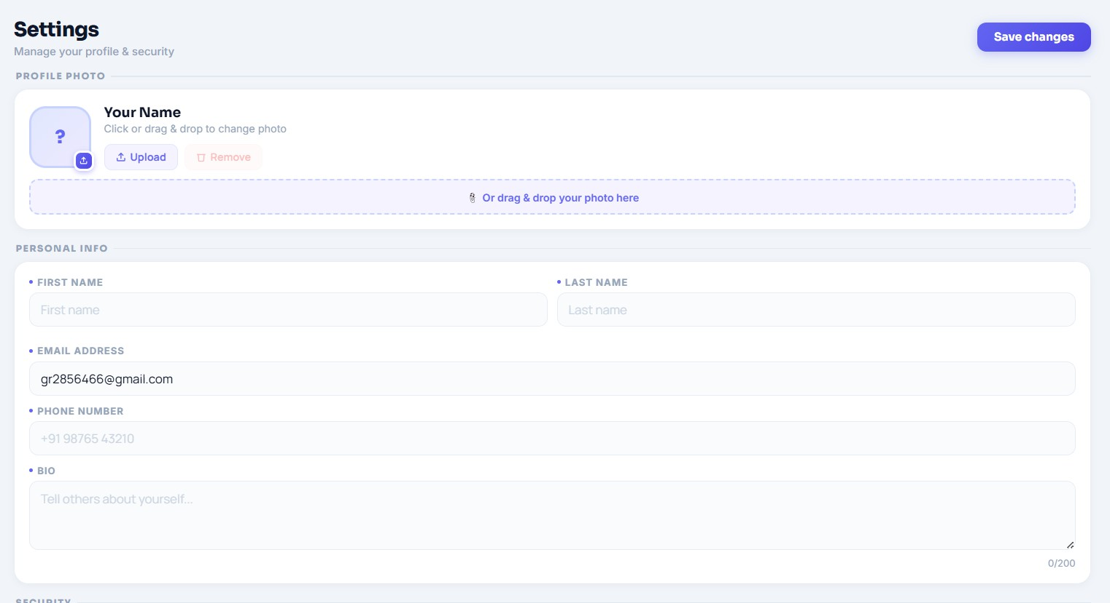
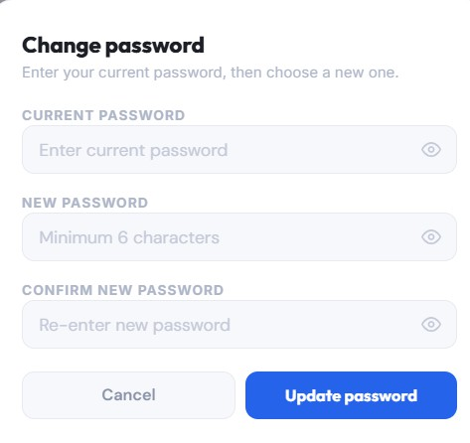
Profile Settings:
User profile settings for updating personal details.
Upload and manage profile picture.
Final testing and bug fixing for smooth performance.

Slide 9
Key Features:
User Authentication with secure login and registration.
Task Posting with detailed information (title, location, time, description).
Task Browsing to explore available tasks.
Request System to send and manage task requests.
Accept / Reject functionality for task owners.
Real-time Notifications for task updates.
My Tasks and My Requests management.
Profile C Settings for updating personal information.
User-friendly and responsive interface.
Conclusion:
The project demonstrates an effective solution for real-time task collaboration.
It ensures efficient communication between task owners and helpers.
Provides a scalable and practical approach for real-world applications.

Slide 10
Key Challenges:
Managing real- time request handling between task owners and helpers.
Maintaining data consistency and avoiding duplicate requests.
Ensuring proper data flow between frontend and backend.
Implementing an efficient notification system for instant updates.
Handling multiple user roles (task owner and helper) effectively.

Slide 11
Outcomes:
Successfully developed a functional task management platform.
Implemented request handling and notification system effectively.
Improved understanding of full-stack development concepts.
Gained practical experience in real-world application development.
Ensured efficient task workflow from creation to completion.
Gained practical experience in real-world application development.

Slide 12
Workflow of the Project
Login
Dashboard
Post Task
Request
Accept/Reject
Task Assigned
Completed

Slide 13
THANK YOU !
ANY QUESTIONS ?

